Slide 1
Charities Services
Our purpose is
PROMOTING
PUBLIC TRUST
and
Charities litigation – pending advocacy appeals
CONFIDENCE
IN CHARITIES

Slide 2
Te Rātā Atawhai
Te Rāta Atawhai, the independent Charities Registration Board, is responsible for registering and deregistering charities.
The majority of decisions are made by Charities Services under delegation.
All complex or novel applications are considered by the Board.

Slide 3
Advocacy for a point of view
Re Greenpeace of New Zealand Incorporated [2014] NZSC 2015
End
End that is advocated
Means
Means to achieve that end
How?
Manner
Manner in which the cause is promoted
What?
Why?

Slide 4
“advancement of causes will often, perhaps most often, be non-charitable”

Slide 5
Greenpeace – current appeal
Board declined Greenpeace’s application
Purpose to promote Greenpeace’s particular views about environmental issues does not advance charitable public benefit
Illegal purpose inferred from illegal activities of Greenpeace and its members disqualifies it from being a charity
Appeal and Judicial Review currently with High Court

Slide 6
Family First – current appeal
Board deregistered Family First
Purposes to promote its own views about marriage and traditional family do not advance charitable public benefit
Does not have an educational purpose
High Court dismissed appeal
Appeal currently with Court of Appeal

Slide 7
Better Public Media Trust – current appeal
Board declined Better Public Media Trust
Purpose to promote views on public service media does not advance a charitable public benefit
Advocating for increased funding for public service media
Promoting views on the importance of public service media
Appeal currently with High Court

Slide 8
Modernising the Charities Act
Greater clarify would benefit charities, the regulator and the public
Discussion document asks questions about advocacy
Would people like to see greater freedom for charities to advocate for policy or law change? What are the benefits and risks?
Should there be limits on advocacy by charities? If so, what?

Slide 9
Questions?
Joe.buchanan@dia.govt.nz

Slide 10
A New Zealand update
Steven Moe
Partner
DDI: +64 3 928 1494
M: +64 21 761 292
E: stevenmoe@parryfield.com

Slide 11
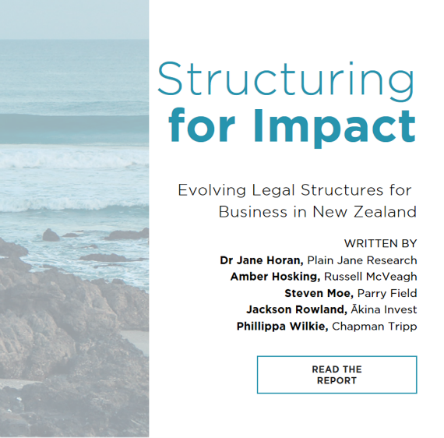
Impact Report
Foreign charities in NZ

Slide 12
www.theseeds.nz

Slide 13
Thank you
stevenmoe@parryfield.com

Slide 14
Update on the review of the Charities Act 2005
1 August 2019

Slide 15
The process so far
Draft terms of reference – February – March 2018, finalised May 2018
Core reference group established August 2018
6 members, 3 elected by the Sector User Group
Department of Internal Affairs’ discussion document issued – February 2019
Independent research project: https://www.strategicgrants.co.nz/free-resources/charities-act-community-consultation
Community engagement meetings, March – April 2019
Submissions closed 31 May 2019 – more than 350 submissions
SUE BARKER CHARITIES LAW

Slide 16
Sincere thanks to:

Slide 17
Issues:
Labour Party policy – first principles review
Terms of reference too narrow
Timeframe too short
Key message:
we risk making the situation worse
the issues in this area of law are complex, and their impact far-reaching
we need an independent Law Commission review, as occurred with incorporated societies and trusts
New Minister July 2019
SUE BARKER CHARITIES LAW

Slide 18
Other reviews:
Report of the Welfare Advisory Group Kia Piki Ake
He Waka Roimata report
Tax Working Group
Taxation (Annual Rates for 2018-19, Modernising Tax Administration, and Remedial Matters) Act 2019
Trusts Bill 290-2
SDG Report
SUE BARKER CHARITIES LAW

Slide 19
Other reviews:
Australia
Scotland
Ireland
Singapore
Zambia
Khyber Pakhtunkhwa
SUE BARKER CHARITIES LAW

Slide 20
Last word:
Charity Law Association of Australia and New Zealand:
New Zealand conference 30 April – 1 May 2020
Expressions of interest: http://www.charitylawassociation.org.au/events-nzconf2020
Facebook page: Charities Act Review 2019: https://www.facebook.com/groups/1932023316889903/
LinkedIn group: NZ Charity Law

Slide 21
Questions?

